Slide 1
THE RISKS AND PERILS OF OCCUPATIONAL FRAUD AT THE TAX COLLECTOR’S OFFICE
Florida Tax Collectors Fall Education Forum 2012
By
Andrew Laflin, CPA
Manager
CliftonLarsonAllen LLP

Slide 2
Objectives
At the end of this session, you will be able to:
Understand the latest fraud risks affecting tax collector operations
Be aware of the impact fraud has on your organization
Identify methods that will help mitigate your fraud risks
Understand your responsibilities relating to fraud prevention and detection.
How ‘big’ is Fraud? Estimated $2.9 Trillion Worldwide*
* Source – 2010 Report to the Nation on Occupational Fraud and Abuse

Slide 3
Example of Fraud at a Car Wash
Bill owns a company that manufactures and installs car wash systems
Bill's company installed a car wash system in Orlando, FL
These are complete systems, including the money changer and money taking machines

Slide 4
Car Wash Example, Cont.
The problem started when the new owner complained to Bill that he was losing significant amounts of money from his coin machines each week
He went as far as to accuse Bill's employees of having a key to the boxes and ripping him off!
Bill just couldn't believe that his people would do that, so he set up a camera to catch the thief in action.
Well, they caught him (or her)!

Slide 5
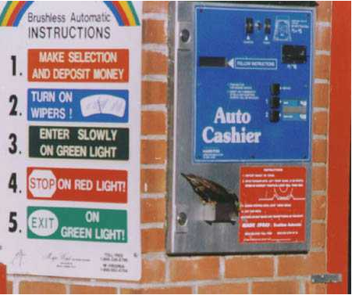
Car Wash Example, Cont.

Slide 6
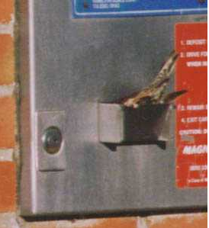
Car Wash Example, Cont.

Slide 7
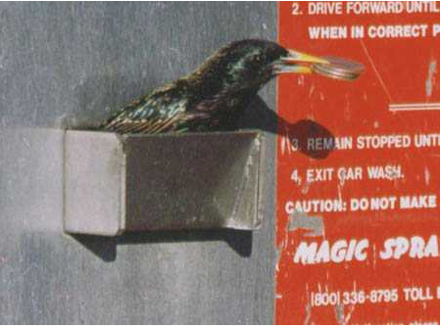
Car Wash Example, Cont.

Slide 8
Car Wash Example, Cont.
Another amazing thing is that it was not just one bird -- there were several working together
Once they identified the thieves, they found over $4,000 in quarters on the roof of the car wash and more under a nearby tree.

Slide 9
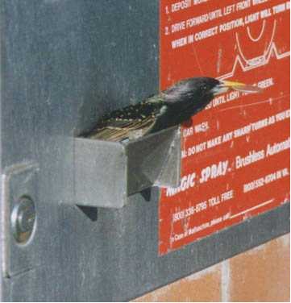
Car Wash Example, Cont.

Slide 10
Car Wash Example, Cont.
This gives a new twist to the term "nest egg".

Slide 11
Car Wash Example, Cont.
And to think the phrase “bird brain” is associated with being dumb.

Slide 12
COSO Framework

Slide 13
Definition
The Committee of Sponsoring Organizations of the Treadway Commission (COSO) Framework defined internal control as follows:
Internal control is a process, effected by an entity's board of directors, management, and other personnel, designed to provide reasonable assurance regarding the achievement of objectives in the following categories:
  Effectiveness and efficiency of operations
  Reliability of financial reporting
  Compliance with applicable laws and regulations

Slide 14
COSO Updates
COSO has released an exposure draft in December 2011 to update its 1992 internal control framework.
Final framework is scheduled for release late in 2012.
Exposure draft updates the framework for globalization, technological advancements and new business models, and provides examples to aid application.

Slide 15
COSO Updates, cont.
The original five components of the framework – control environment, risk assessment, control activities, information and communications, and monitoring activities – remain the same.
New to the framework are 17 principles across the five components of internal control. Each principle also is described with specific attributes in the framework.

Slide 16
5 Components of the COSO Framework
Control Environment: This is the foundation for all other components of internal control, providing discipline, process and structure as established by the board and senior management.
Risk Assessment: The basis for how risks should be managed involves a dynamic process. Management must consider possible changes in the external environment and within the business that may be obstacles to its objectives.
Control Activities: These are established to help ensure management’s directives to mitigate risks get carried out. Control activities are performed at all levels and at various stages within the business process and over technology
Information and Communication: Communication must occur internally and externally to provide information needed to carry out day-to-day internal control activities. All personnel must understand their responsibilities.
Monitoring Activities: Evaluations ascertain whether each component of internal control is present and functioning. Deficiencies are communicated in a timely manner, with serious matters reported to senior management and the board.

Slide 17
17 Principles – Control Environment
Commitment to integrity and ethics.
Oversight for internal control by the board of directors, independent of management.
Structures, reporting lines and appropriate responsibilities in the pursuit of objectives established by management and overseen by the board.
A commitment to attract, develop and retain competent individuals in alignment with objectives.
Holding individuals accountable for their internal control responsibilities in pursuit of objectives

Slide 18
17 Principles, Cont. – Risk Assessment
Specifying objectives clearly enough for risks to be identified and assessed.
Identifying and analyzing risks in order to determine how they should be managed.
Considering the potential of fraud.
Identifying and assessing changes that could significantly impact the system of internal control.

Slide 19
17 Principles, Cont. – Control Activities
Selecting and developing controls that help mitigate risks to an acceptable level.
Selecting and developing general control activities over technology.
Deploying control activities as specified in policies and relevant procedures

Slide 20
17 Principles, Cont. – Information & Communication
Obtaining or generating relevant, high-quality information to support internal control.
Internally communicating information, including objectives and responsibilities, necessary to support the other components of internal control.
Communicating relevant internal control matters to external parties

Slide 21
17 Principles, Cont. - Monitoring Activities
Selecting, developing and performing ongoing or separate evaluations of the components of internal control.
Evaluating and communicating deficiencies to those responsible for corrective action, including senior management and the board of directors, where appropriate

Slide 22
Good People [sometimes] Make Bad Choices

Slide 23
Occupational Fraud
Presentation Focus: Occupational Fraud
Definition: The use of one’s occupation for personal enrichment through the deliberate misuse or misapplication of the employing organization’s resources or assets.
Occupational Fraud is far and away the largest source of fraud loss
Source – 2010 Report to the Nation on Occupational Fraud and Abuse

Slide 24
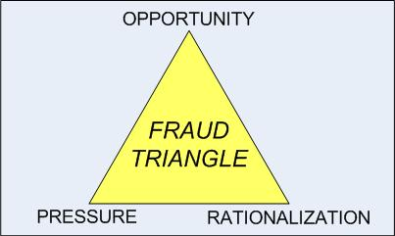
Fraud Triangle
Fraud Triangle
Incentives / pressure to commit fraud
Attitudes / rationalizations
Opportunities to commit fraud
Most frauds occur over long time horizons – Approx. 1-2 years median time from start to detection.

Slide 25
Who Commits Fraud (All Industries)?
Male or female?
Over 40 or under 40?
Employees, managers, or executives?
Income under $100,000 or over $100,000?
High school graduate and some college, bachelor’s degree, or post-graduate degree?

Slide 26
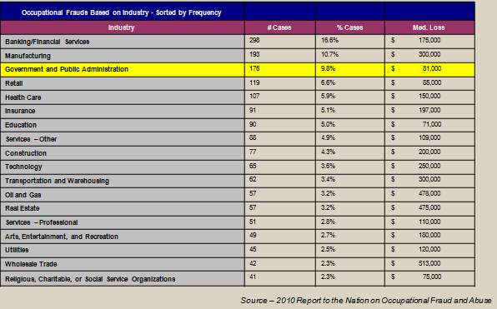
Types of Frauds and Frequency by Industry

Slide 27
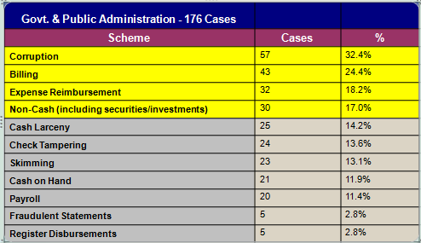
Types of Frauds and Frequency
Source – 2010 Report to the Nation on Occupational Fraud and Abuse

Slide 28
Fraud Varies by Industry and Organization Size
As these slides indicate – the incidence and dollar value of fraud varies by industry and organization size
To research your organization’s likely risks given industry and size look to The 2010 ACFE Report to the Nation
  Best source to research organizational exposure by industry and firm size, available on line free at http://www.acfe.com/uploadedFiles/ACFE_Website/Content/documents/rttn-2010.pdf

Slide 29
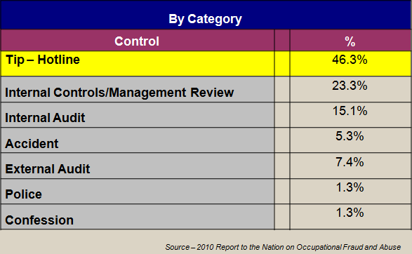
Anti-Fraud Measures – Government Cases

Slide 30
Anti-Fraud Measures (Used vs. Used Successfully)
Across all organizations, Occupational Frauds are more likely to be detected by a tip than by other means such as internal audits, external audits or internal controls
Make detection easier – have an anonymous tip line

Slide 31
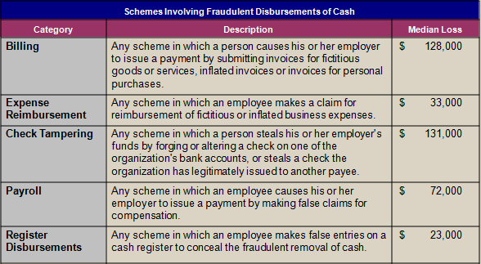
Types of Frauds and Loss Size
Source – 2010 Report to the Nation on Occupational Fraud and Abuse

Slide 32
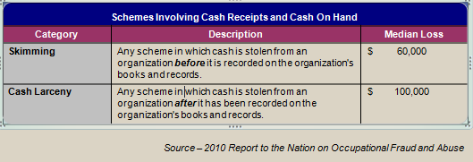
Types of Frauds and Loss Size II
Organizations tend to focus on Cash Larceny, (theft after it is on the books), rather than Skimming, (theft before it is on the books) – both are important economic losses to the organization

Slide 33
Factors that Contribute to/Allow Fraud
Primarily internal control weaknesses:
  Lack of internal controls (38%)
  Lack of management review (18%)
  Override of existing controls (19%)
  Poor tone at the top (8%)
  Lack of competent oversight (7%)
  Lack of independent checks/audits (6%)
  Others (4%)
Source – 2010 Report to the Nation on Occupational Fraud and Abuse

Slide 34
Red Flags
Behaviors to be on the watch for?
  Living beyond means (45%)
  Financial difficulties (45%)
  Excessive control/not willing to share duties (23%)
  Family issues (23%)
  Excessive risk taker (20%)
  Unusually close relationship with vendors (16%)
  Defensiveness (15%)
  Addiction (14%)
  Refusal to take vacations (8%)
  And many others
Source – 2010 Report to the Nation on Occupational Fraud and Abuse

Slide 35
Specific TC Fraud Schemes – Billing #1
Employee manipulates his/her own property tax bill or friend’s/relative’s bill (perhaps by changing the assessed property values) to reduce amount owed
Controls to prevent or detect this scheme?
  Reconciliation process between property appraiser records and tax bills generated
  Verify that all changes to assessed values are supported by adequate documentation
Notes:
- Use 3rd party to process property tax bills

Slide 36
Specific TC Fraud Schemes – Billing #2
A clerk changes the sales price of a vehicle (from a private party sale) so the customer pays less in sales tax
Controls to prevent or detect this scheme?
  Management/supervisor performs a review all or a sample of these types of vehicle transactions

Slide 37
Specific TC Fraud Schemes – Billing #3
A clerk issues a vehicle registration to a customer who pays in cash; the clerk then voids the transaction and pockets the cash
Controls to prevent or detect this scheme?
  Generate an exception report that lists all voided DMV transactions in a given day; require backup documentation to justify each void
Notes:
Reason for voiding: registration gets jammed in the printer
Any time you can void a transaction but not retain record of it….that spells trouble

Slide 38
Specific TC Fraud Scheme: Corruption #1
An employee checks the box that an applicant is a U.S. citizen even though he is not; the employee receives a kickback in return
Controls to prevent or detect this scheme?
  Obtain DL Report from DMV listing all applicants whose status was changed to U.S. citizen; require valid documentation supporting the status change

Slide 39
Specific TC Fraud Scheme: Corruption #2
An employee lifts a suspension on a driver’s license for a customer in exchange for a $100 gift certificate to Golden Corral.
Controls to prevent or detect this scheme?
  Obtain Suspension Report from DMV listing all individuals who had license suspension status changes; require valid documentation supporting the status change

Slide 40
Specific TC Fraud Scheme: Collections #1
A clerk is consistently $5 to $9 short every day when reconciling her daily cash collections. The threshold to investigate differences is $10.
Controls to prevent or detect this scheme?
  Document and monitor all over/short discrepancies by each cashier. Tie into periodic staff performance evaluations.
Notes:
Employee background checks

Slide 41
Specific TC Fraud Schemes: Collections #2
Walk-in customer pays property tax bill in cash. Clerk “issues” a manual receipt (or provides no receipt at all) but does not enter the transaction into the system and pockets the cash.
Controls to prevent or detect this scheme?
  Install cameras at cash collection areas; provide signage that all customers must be provided with a valid receipt
Notes:
Other collection issues? Mail in payments intercepted and an employee tries to cash the check? Check made out to name of tax collector or entity name? 3rd party processor of property tax payments made online tries to rip TC off?

Slide 42
Specific TC Fraud Schemes: Disbursements #1
Employee buys gifts for family members while traveling and includes these personal costs on his Expense Reimbursement / Travel Request Form
Controls to prevent or detect this scheme?
  Supervisory review of reimbursement request forms; A/P Clerk should not process payment unless expense form or credit card statement contains evidence of review
Notes:
Who is reviewing the Finance Director’s credit card statement? Who is reviewing the Tax Collector’s travel form?

Slide 43
Specific TC Fraud Schemes: Disbursements #2
Customer is owed a refund on a property tax overpayment but A/P Clerk instead cuts the check to his girlfriend.
Controls to prevent or detect this scheme?
  Review refund requests prior to payment; match up payees on all refund check disbursements to Tax Refund Report
Notes:
Employees could generate a refund without customer knowing it by manipulating the postmarked date on the property tax payment. Thus, customer won’t be expecting a refund.
What if an employee with access to check stock cuts himself a refund check without going through A/P cycle? Control: Positive Pay

Slide 44
Specific TC Fraud Schemes: Disbursements #3
Employee changes wire number or ACH recipient info so as to pay himself instead of a taxing jurisdiction
Controls to prevent or detect this scheme?
  Review payment file prior to sending to bank; ensure file is secure and inaccessible after review prior to transmission to the bank

Slide 45
Specific TC Fraud Schemes: Payroll #1
HR Director reviews and approves all pay rate changes and PTO requests. Since HR Director is the only one who performs this review function, she increases her own pay rate and gives herself additional vacation days.
Controls to prevent or detect this scheme?
  Remove HR Director’s administrative access to payroll system. Access rights should be read-only.

Slide 46
Fraud Controls
Detective Controls - designed to detect fraud after it has occurred.
Examples:
Exception reports are reviewed and cleared by persons with appropriate authority.
Systems maintenance reports are reviewed to ensure changes are completed properly and authorized.
Documentation reviews are completed to ensure files are complete.

Slide 47
Fraud Controls II
Preventative Controls - designed to prevent fraud before it has occurred.
Examples:
Regular balancing and reconciling are completed by an individual independent of the transactions processed through the account.
Passwords and physical safeguards are established to restrict access to appropriate personnel.
Authorization and limits are established to ensure the appropriate oversight of significant transactions.

Slide 48
Fraud Awareness – Types of Controls
Automated Controls - controls that automatically occur.
Examples:
Computer passwords are implemented to
automatically control the access to the systems.
Manual Controls - controls that must be manually completed.
Examples:
Correspondent account reconciliations must be
manually completed using the account statement and
the general ledger history.

Slide 49
Best Practices to Combat Fraud
Be sure that everyone understands their roles – have clear job descriptions and proper training.
Ensure that policies and procedures are documented.
Require annual vacations of employees – someone else must perform their duties while gone.
Evaluate “immaterial” journal entries.
NO employee should have custody and recordkeeping responsibilities for assets – especially cash/investments.
Know your personnel (do background checks).

Slide 50
Best Practices to Combat Fraud (Continued)
Establish a budget/use it as a monitoring tool.
Compare financial statements to prior year timeframe on a monthly basis.
Minimize the number of bank accounts used.
Accounts must be reconciled timely and review by an individual not involved in the reconciliation process.

Slide 51
Summary
A better understanding of fraud risks as the relate to your organization
Keep your guard up, but accept that you can’t prevent ALL bad things from happening.
Brainstorm where risks exist to prevent theft.
Benefits of controls should exceed costs.
Be creative when attempting to segregate duties.
Identified some solutions to help you mitigate fraud risks.
Understand how are frauds can be perpetrated.
Overall be more aware of the potential for frauds in your entity and what are your related responsibilities.

Slide 52
Questions and Comments
Andrew Laflin, CPA
Manager
CliftonLarsonAllen LLP
(813) 384-2711 (office)
(813) 784-3140 (cell)
andrew.laflin@cliftonlarsonallen.com

